Slide 1
Math 152
Lesson | Topic | Reading
26 | Series | 11.2
27 | Testing Series | 11.3/11.7
28 | Comparison tests/alternating series | 11.4/11.5
Objectives:
Identify appropriate convergence test for a given series
Recognize when to use the INTEGRAL TEST to show convergence or divergence
Know the definition of a P-SERIES and determine convergence

Slide 2
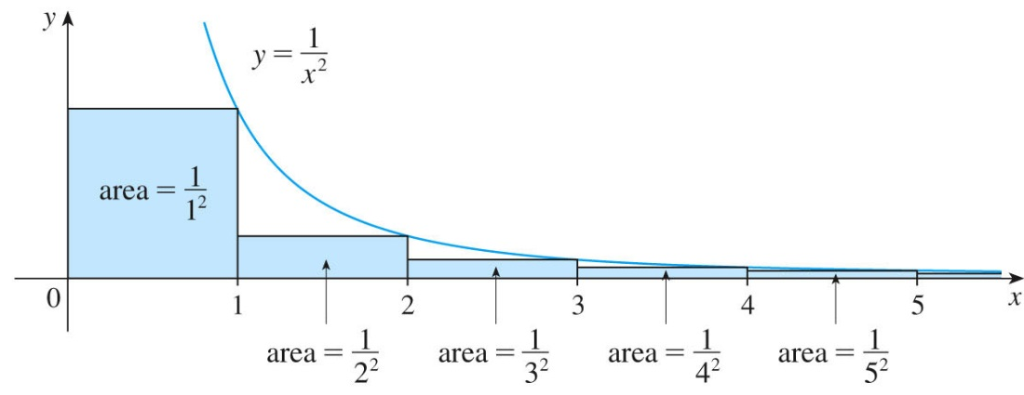
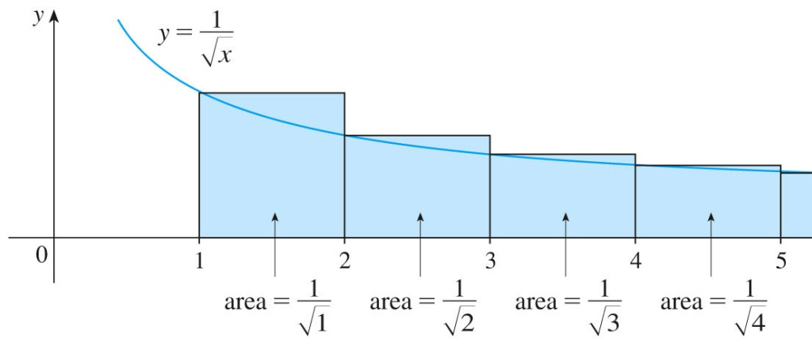
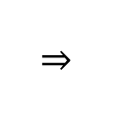

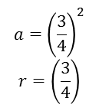

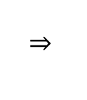
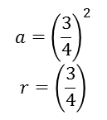
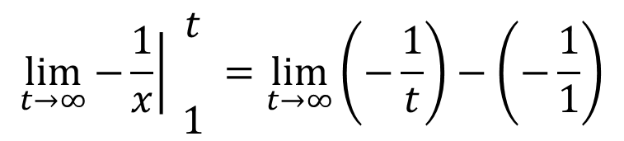
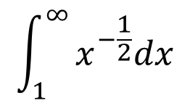
Integral Test
$$\sum_{n=1}^{∞}{\frac{1}{n^{2}}}$$
$$\sum_{n=1}^{∞}{\frac{1}{\sqrt{n}}}$$
$$\int_{1}^{∞}{x^{−2}}dx$$
$$\int_{1}^{∞}{x^{−\frac{1}{2}}dx}$$
$$\lim_{t→∞}{\int_{1}^{t}{x^{−2}}dx}$$
$$\lim_{t→∞}{\int_{1}^{t}{x^{−\frac{1}{2}}dx}}$$
$$\lim_{t→∞}\left.−\frac{1}{x}\right|\begin{matrix}t \\ \\ 1\end{matrix}=\lim_{t→∞}\left(−\frac{1}{t}\right)−\left(−\frac{1}{1}\right)$$
$$\left.\lim_{t→∞}{2x^{\frac{1}{2}}}\right|\begin{matrix}t \\ 1\end{matrix}=\lim_{t→∞}\left(2\sqrt{t}\right)−\left(2\sqrt{1}\right)$$
Notes:
Must be continuous, positive and decreasing! (Ultimately)
Limit tells IF it converges, not what it converges to!
Doesn’t matter where you start (if there is a discontinuity, a = (1/(n-100)), then start AFTER the discontinuity
For p>1, proving that it CONVERGES, therefore you want an upper bound.
the RHS of a (+)concavity, decreasing function gives an UNDER estimate, making the integral an UPPER bound
if the UPPER bound converges, then the series must converge
we don’t know what it converges “to”…just that it converges. (note, the limit of the integral is 1, as is the first term of the series.)
For p<1, proving that it DIVERGES, the LHS gives an OVER estimate for (+) decreasing, making the integral a LOWER bound
the integral diverges and the series is greater than the integral, therefore the series DIVERGES

Slide 3
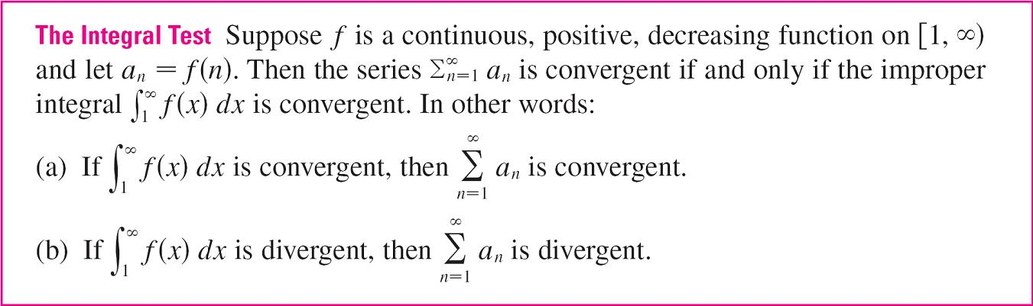

Slide 4
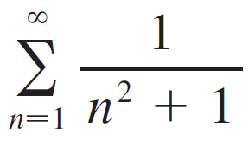
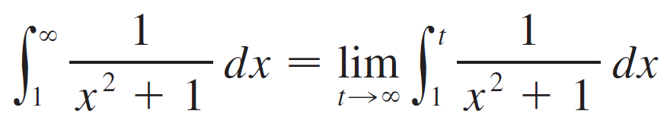
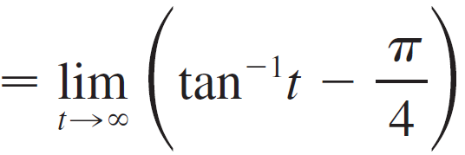
Example 1
Test the series for convergence or divergence.
Solution: The function f (x) = 1/(x² + 1) is continuous, positive, and decreasing on [1,inf) so we use the Integral Test:
Convergent

Slide 5
P-Series
The series is called the p-series.

Slide 6
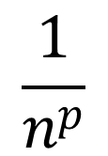
p < 1
$$\frac{1}{n^{p}}$$
p = 1
p > 1

Slide 7
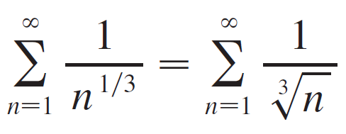
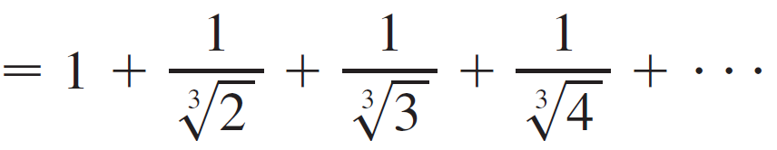
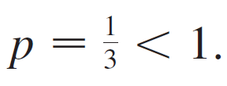
Example
(a) The series
is convergent because it is a p-series with p = 3 > 1.
(b) The series
is divergent because it is a p-series with

Slide 8
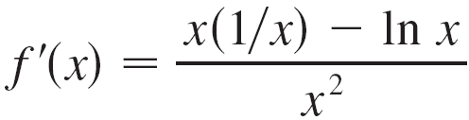
Example
Determine whether the series converges or diverges.
Solution:
The function f (x) = (ln x)/x is positive and continuous for x > 1 because the logarithm function is continuous.
But it is not obvious whether or not f is decreasing, so we compute its derivative:

Slide 9
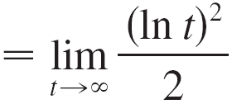
Example
Thus f '(x) < 0 when ln x > 1. It follows that f is decreasing when x > 1 and so we can apply the Integral Test:
Since this improper integral is divergent, the series Σ (ln n)/n is also divergent by the Integral Test.

Slide 10

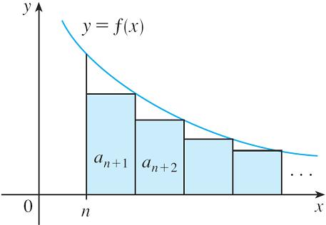
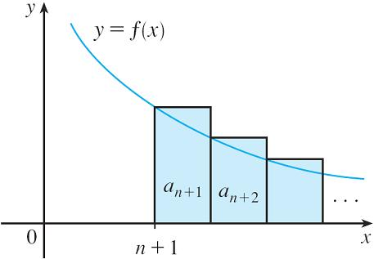

Estimating the Sum of a Series
We use the same notation and ideas as in the Integral Test, assuming that f is decreasing on [n, ). Comparing the areas of the rectangles with the area under y = f (x) for x > n in Figure 3, we see that
Similarly, we see from Figure 4 that
Under Est
Figure 3
Over Est
Figure 4

Slide 11
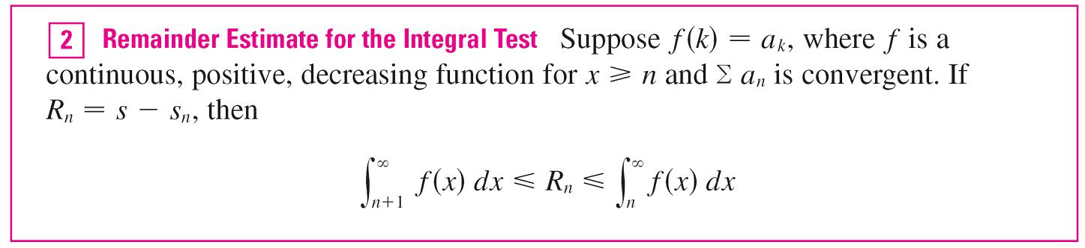
Estimating the Sum of a Series
So we have proved the following error estimate.

Slide 12
Example
(a) Approximate the sum of the series Σ 1/n³ by using the sum of the first 10 terms. Estimate the error involved in this approximation.
(b) How many terms are required to ensure that the sum is accurate to within 0.0005?
Hint: use theorem 2

Slide 13
Example
(a) Approximate the sum of the series Σ 1/n³ by using the sum of the first 10 terms. Estimate the error involved in this approximation.
(b) How many terms are required to ensure that the sum is accurate to within 0.0005?
Solution:
In both parts (a) and (b) we need to know With f (x) = 1/x³, which satisfies the conditions of the Integral Test, we have
Continuous, positive, decreasing

Slide 14
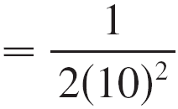
Example
(a) Approximating the sum of the series by the 10th partial sum, we have
According to the remainder estimate in , we have
So the size of the error is at most 0.005.

Slide 15
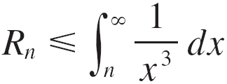
Example 5
(b) Accuracy to within 0.0005 means that we have to find a value of n such that R_{n} ≤ 0.0005. Since
we want
Solving this inequality, we get
We need 32 terms to ensure accuracy to within 0.0005.

Slide 16
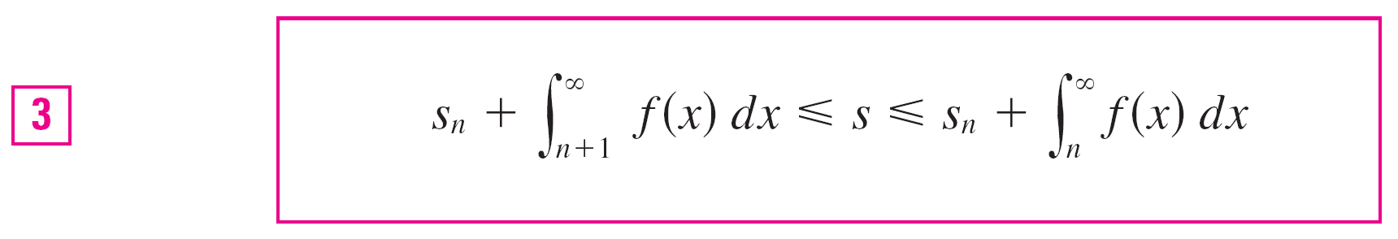
Estimating the Sum of a Series
If we add s_{n} to each side of the inequalities in , we get
because s_{n} + R_{n} = s. The inequalities in give a lower bound and an upper bound for s.
They provide a more accurate approximation to the sum of the series than the partial sum s_{n} does.

Slide 17
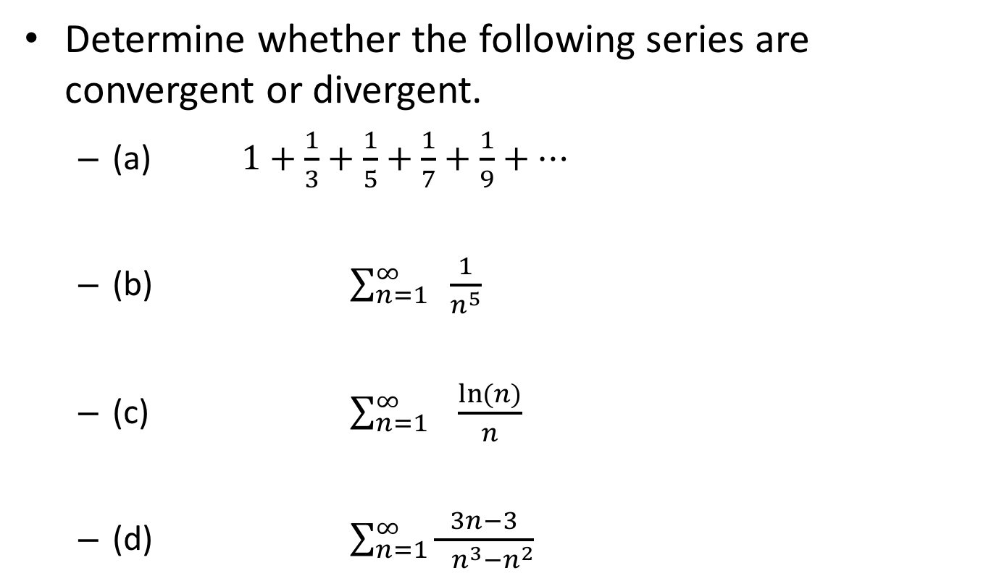
Board Work
Determine whether the following series are convergent or divergent.
(a) $1+\frac{1}{3}+\frac{1}{5}+\frac{1}{7}+\frac{1}{9}+⋯$
(b) $\sum_{n=1}^{∞}{ \frac{1}{n^{5}}}$
(c) $\sum_{n=1}^{∞}{ \frac{\ln{(n)}}{n}}$
(d) $\sum_{n=1}^{∞}{\frac{3n−3}{ n^{3}−n^{2}}}$
diverge
P-series, p>1,converge
diverge
Converge, 3/2
Notes:
Does answer match p-series or common sense?
1/(2n-1)

Slide 18





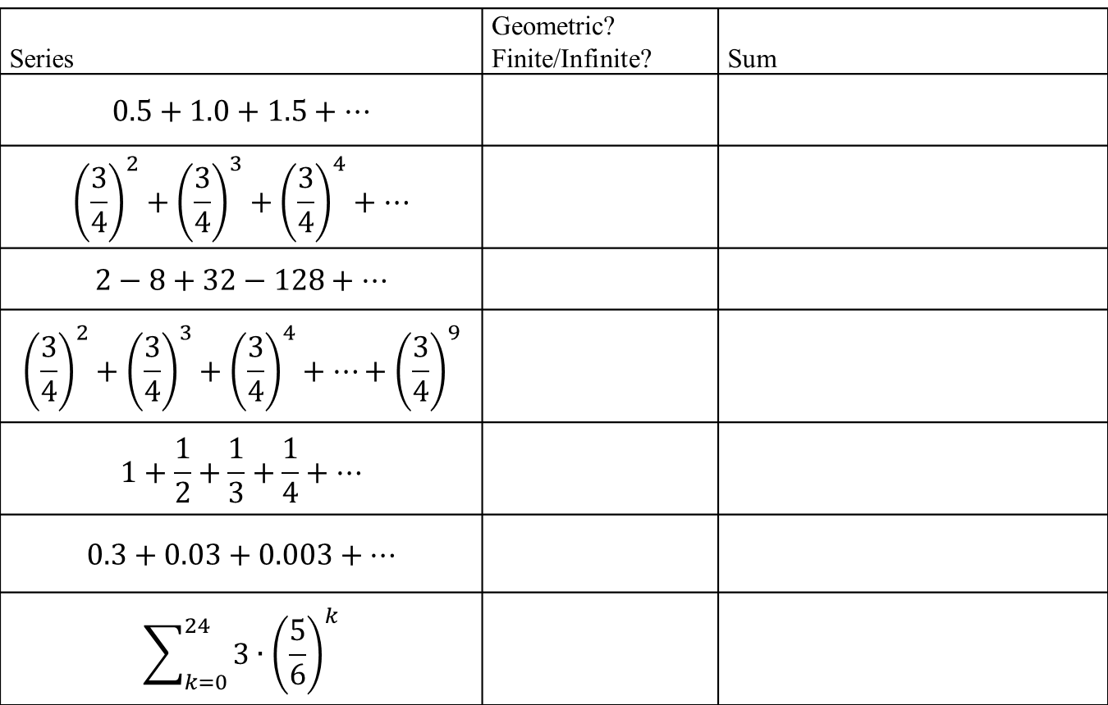


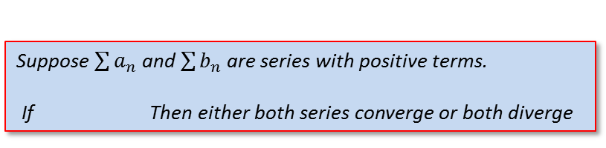
Board Work
Series | Geometric? Finite/Infinite? | Sum
$$0.5+1.0+1.5+⋯$$
$${\left(\frac{3}{4}\right)}^{2}+{\left(\frac{3}{4}\right)}^{3}+{\left(\frac{3}{4}\right)}^{4}+⋯$$
$$2−8+32−128+⋯$$
$${\left(\frac{3}{4}\right)}^{2}+{\left(\frac{3}{4}\right)}^{3}+{\left(\frac{3}{4}\right)}^{4}+⋯+{\left(\frac{3}{4}\right)}^{9}$$
$$1+\frac{1}{2}+\frac{1}{3}+\frac{1}{4}+⋯$$
$$0.3+0.03+0.003+⋯$$
$$\sum_{k=0}^{24}{3∙{\left(\frac{5}{6}\right)}^{k}}$$
NG / Infinite
$$∞$$
$$a={\left(\frac{3}{4}\right)}^{2}$$
$$r=\left(\frac{3}{4}\right)$$
$$\frac{{\left(\frac{3}{4}\right)}^{2}}{\left(1−\left(\frac{3}{4}\right)\right)}$$
G / Infinite
G / Infinite
$$Oscilates$$
$$a={\left(\frac{3}{4}\right)}^{2}$$
$$r=\left(\frac{3}{4}\right)$$
$$\frac{{\left(\frac{3}{4}\right)}^{2}\left(1−{\left(\frac{3}{4}\right)}^{8}\right)}{\left(1−\left(\frac{3}{4}\right)\right)}$$
G / Finite
$$∞$$
NG / Infinite
$$a=0.3$$
$$r=\left(0.1\right)$$
$$\frac{0.3}{\left(1−\left(0.1\right)\right)}$$
G / Infinite
$$a=3$$
$$r=\left(\frac{5}{6}\right)$$
$$\frac{3\left(1−{\left(\frac{5}{6}\right)}^{25}\right)}{\left(1−\left(\frac{5}{6}\right)\right)}$$
G / Finite
Notes:
“+…” is infinite
1.0/0.5 = 2, 1.5/1.0=1.5, therefore NOT geometric $a_{n}$ = (0.5)n, the limit as n approaches infinity DNE
$a={\left(\frac{3}{4}\right)}^{2}$ because the summation is from 0 to INF (not 1 to INF) for the convergence to $\frac{a}{1−r}$ to work
a = 2, r = -4. abs(r) = abs(-4) = 4 which is >1, therefore NOT convergent
$the first term, a={\left(\frac{3}{4}\right)}^{2}$ , and $r=\left(\frac{3}{4}\right), but the series is finite with first 8 terms,$so use $S_{n}=\frac{a(1−r^{n})}{(1−r)}$
$a_{n}$ = 1/n. Although $a_{n}$ itself converges to 0, the “series” diverges (p708, example 8)
25 terms (0 to 24)

Slide 19
Backups

Slide 20
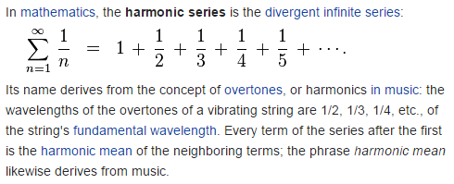

Harmonic Series
Notes:
http://en.wikipedia.org/wiki/Harmonic_series_(mathematics)

Slide 21
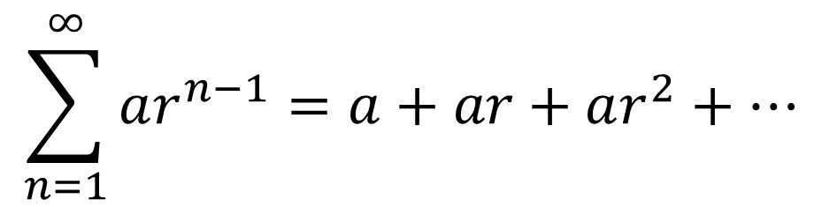

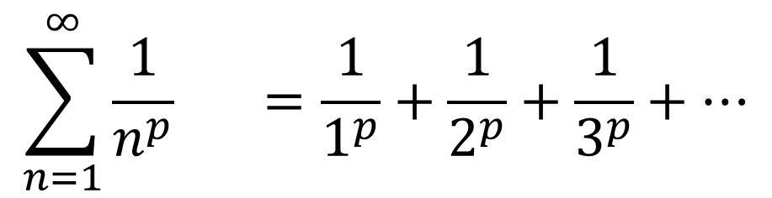
Series
$$\sum_{n=1}^{∞}{ar^{n−1}}=a+ar+ar^{2}+⋯$$
Geometric Series:
Converges to $\frac{a}{1−r}$ when $−1<r<1$
$$\sum_{n=1}^{∞}{\frac{1}{n^{p}}} =\frac{1}{1^{p}}+\frac{1}{2^{p}}+\frac{1}{3^{p}}+⋯$$
$p$-Series:
Converges when $p>1$
Notes:
P-series diverges for p<1…if p=1 (1 + ½ + 1/3 + ¼ +…) also diverges
Some future tests will compare agains g & p-series

Slide 22
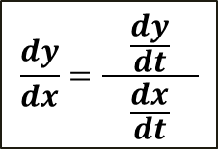
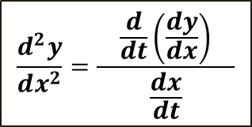
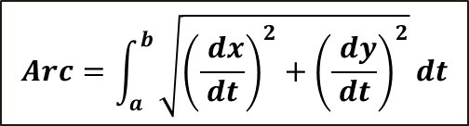
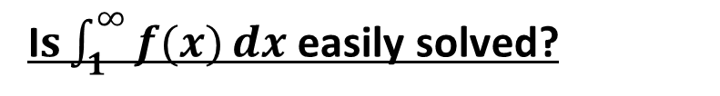
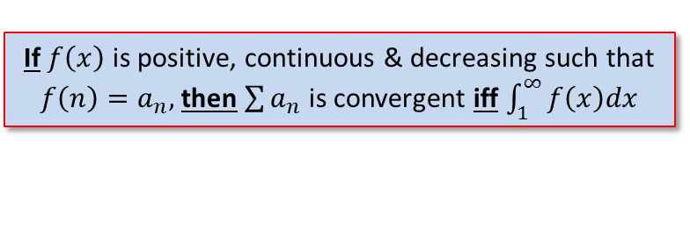

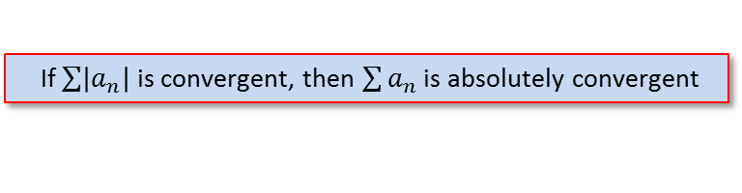
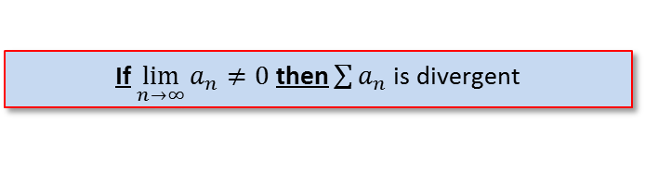
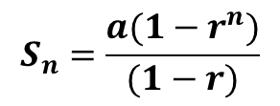

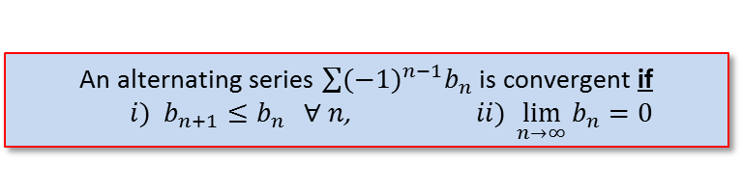

Strategy for Testing Series
Test for Divergence
If $\lim_{n→∞}{a_{n}≠0}$ then $\sum{a_{n}}$ is divergent
g-series?
Geometric converges to $\frac{a}{1−r}$ when $−1<r<1$
p-series?
$p$-series converges when $p>1$
“like” a g- or p-series?
Comparison Test
$\sum{b_{n}}$ convergent and $a_{n}≤b_{n}$ $∀$ $n$ $\sum{a_{n}}$ convergent
$\sum{b_{n}}$ divergent and $a_{n}≥b_{n}$ $∀$ $n$ $\sum{a_{n}}$ divergent
Limit Comparison Test
Suppose $\sum{a_{n}}$ and $\sum{b_{n}}$ are series with positive terms.
If Then either both series converge or both diverge
$$\lim_{n→∞}{\frac{a_{n}}{b_{n}}}=c$$
Alternating Series?
An alternating series $\sum{{(−1)}^{n−1}b_{n}}$ is convergent if
$i) b_{n+1}≤b_{n} ∀ n$, $ii) \lim_{n→∞}{b_{n}=0}$
If $\sum{\left|a_{n}\right|}$ is convergent, then $\sum{a_{n}}$ is absolutely convergent
$L<1\overset{⇒}{}$ AC
$L>1\overset{⇒}{}$ D
$L=1\overset{⇒}{}$ ??
${\text{"!" }\text{or} \left(constant\right)}^{n}$?
$$\lim_{n→∞}\left|\frac{a_{n+1}}{a_{n}}\right|=L$$
${\left(a_{n}\right)}^{n}$?
$$\lim_{n→∞}{\sqrt[n]{\left|a_{n}\right|}}=L$$
I$s\int_{1}^{∞}{f(x)}dx$ easily solved?
If $f\left(x\right)$ is positive, continuous & decreasing such that $f\left(n\right)=a_{n},$then$\sum{a_{n}}$ is convergent iff $\int_{1}^{∞}{f\left(x\right)dx}$
Notes:
Section 11.7, p739
Comparison test: if the term is a rational function or an algebraic function of n (involving roots of polynomials), then the series should be compared with a p-series, keeping only the highest powers of n in the numerator & denominator
Ratio & Root test: inconclusive if L = 1, or DNE

Slide 23

Given $$\sum_{n=0}^{∞}{\frac{3n+2}{5n+1}}$$
Compute $s_{3}$.
Determine if the series converges or diverges (see page 709).
Does the following series converge or diverge? Why? If it converges, find its sum. $$\sum_{n=1}^{∞}{\frac{{\left(−2\right)}^{n}}{3^{n+2}}}$$
For what values of $x$ does the following series converge? $$\sum_{n=0}^{∞}{ {\left(2x−5\right)}^{n}}$$
For the series in problem #3, using $x=2.3$, what is the sum of the first 13 terms?

Slide 24
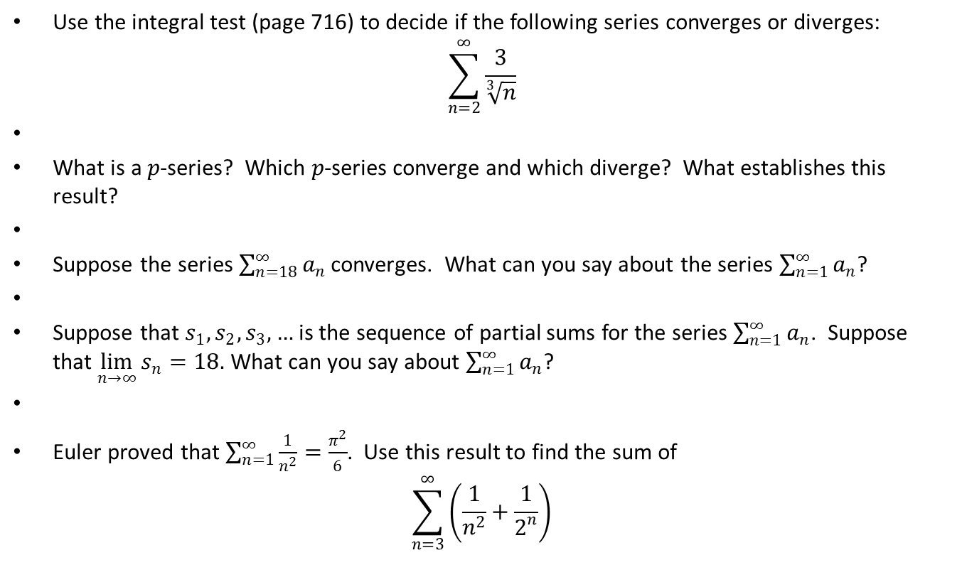
Use the integral test (page 716) to decide if the following series converges or diverges: $\sum_{n=2}^{∞}{\frac{3}{\sqrt[3]{n}}}$
What is a $p$-series? Which $p$-series converge and which diverge? What establishes this result?
Suppose the series $\sum_{n=18}^{∞}{a_{n}}$ converges. What can you say about the series $\sum_{n=1}^{∞}{a_{n}}$?
Suppose that $s_{1},s_{2},s_{3},…$ is the sequence of partial sums for the series $\sum_{n=1}^{∞}{a_{n}}$. Suppose that $\lim_{n→∞}{s_{n}}=18.$ What can you say about $\sum_{n=1}^{∞}{a_{n}}$?
Euler proved that $\sum_{n=1}^{∞}{\frac{1}{n^{2}}=\frac{π^{2}}{6}}$. Use this result to find the sum of $\sum_{n=3}^{∞}{\left(\frac{1}{n^{2}}+\frac{1}{2^{n}}\right)}$

Slide 25
Warm-Up

Slide 26
Bronze

Slide 27
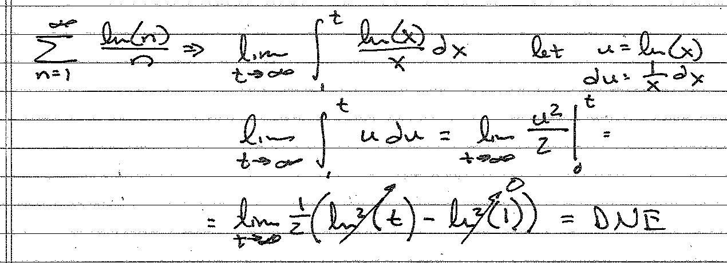
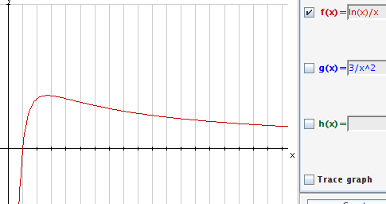
Silver

Slide 28
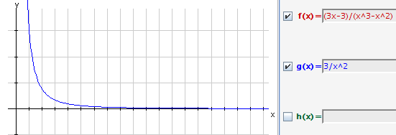

Gold

Slide 29

Notes:
(-10/3)lim(x^(-3/10)) evaluated from 1 to t
(-10/3)lim[1/t^(3/10) – 1/1] = (-10/3)[ 0 – 1 ] = 10/3

Slide 30

11.3 #7

Slide 31

Notes:
Pg 708

Slide 32

11.3 #15

